Slide 1



Windows 10 IOT (.10586) + Raspberry Pi 2
krzysztof.krzyskow@gmail.com
@KrzyskowK
ChrisOrTwo
Internet Of Things by Microsoft

Slide 2
krzysztof.krzyskow@gmail.com
@KrzyskowK
ChrisOrTwo

Slide 3

krzysztof.krzyskow@gmail.com
@KrzyskowK
ChrisOrTwo

Slide 4

krzysztof.krzyskow@gmail.com
@KrzyskowK
ChrisOrTwo

Slide 5
krzysztof.krzyskow@gmail.com
@KrzyskowK
ChrisOrTwo

Slide 6

krzysztof.krzyskow@gmail.com
@KrzyskowK
ChrisOrTwo

Slide 7
Windows 10 IOT (.10586) + Raspberry Pi 2
Internet Of Things by Microsoft

Slide 8
What is Windows 10 IoT Core?
https://dev.windows.com/en-us/iot

Slide 9
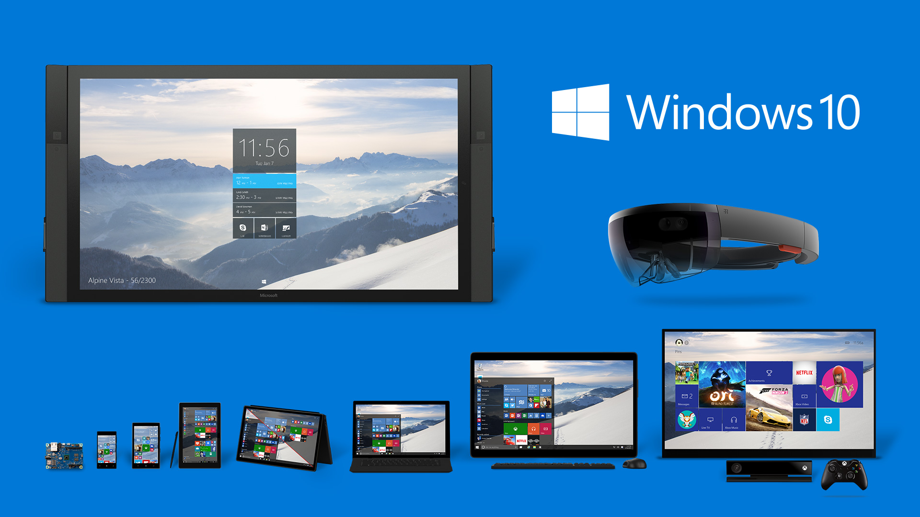
What is Windows 10 IoT Core?
Notes:
Windows 10 IoT Core is a version of Windows 10 designed specifically for use in small footprint, low-cost devices and IoT scenarios.
rebranded version of Windows Embeded.
No UI Shell (no task manager/no rdp/no windows explorer/no media player) NOTHING!
Due to fact that Windows 10 IoT Core supports also ARM architecture not all drivers (so devices as well) that work with Windows 10 are supported in IoT Edition
You can run it on different architecture than x86/x64

Slide 10
What is Windows 10 IoT Core?
HARDWARE REQUIREMENTS:
PROCESSOR: 400 MHz (x86/ARM)
MEMORY: 256 MB (128 MB for OS) - headless mode 512 MB (256 MB for OS) - headed mode
STORAGE: 2 GB
SUPPORTED HARDWERE:
http://ms-iot.github.io/content/en-US/win10/SupportedInterfaces.htm

Slide 11
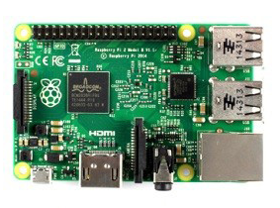
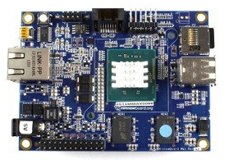
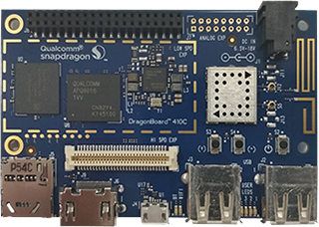
What is Windows 10 IoT Core?
SUPPORTED HARDWARE:
Raspberry PI 2 MinnowBoard MAX Galileo DragonBoard
Notes:
MinnowBoard
Qualcom DragonBoard 410c
- Intel Galilieo not supported since 30 Nov 2015 (due to week performace (only 400MHz CPU))

Slide 12
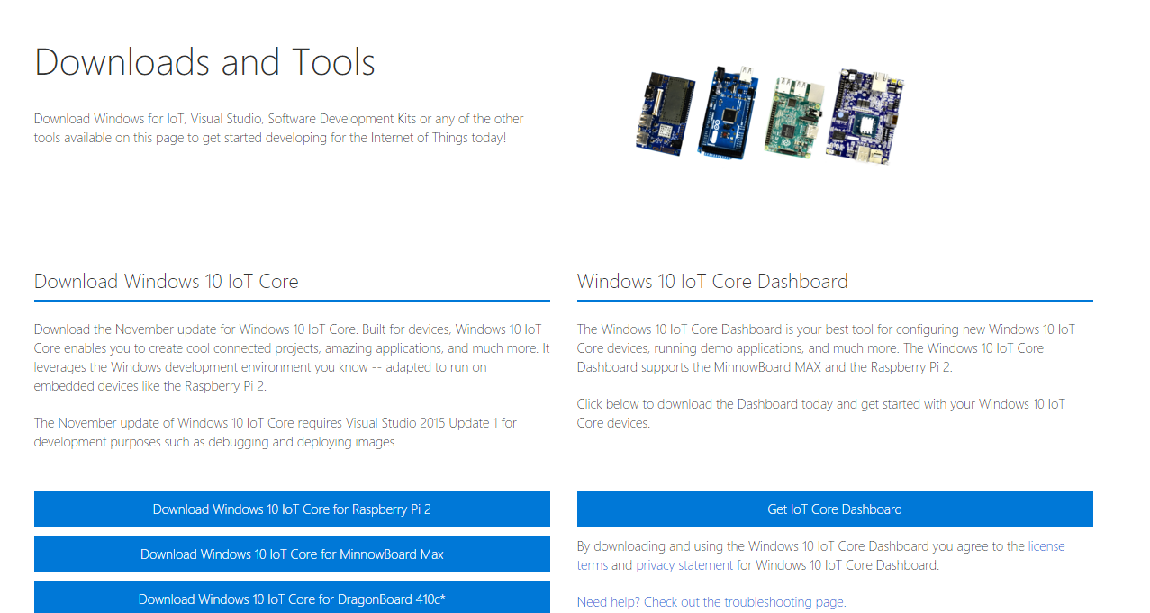
How to install Windows 10 IoT Core?
http://ms-iot.github.io/content/en-US/Downloads.htm
Notes:
Two ways of installation:
1) Manual: Download .iso with flash and WindowsIoTImageHelper – that allows to create Windows 10 IoT instance on you SSD card
2) Download Windows IoT Dashboard. Select device type and it will continue for you
Show website
Show IoT Dashboard

Slide 13
How to manage?
Windows Device Portal
Powershell
SSH
FTP
Windows File Sharing

Slide 14
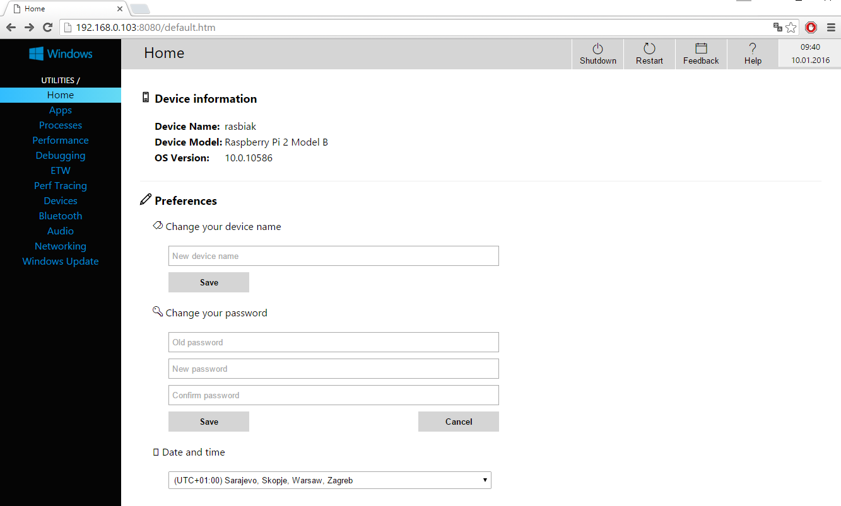
How to manage?
WINDOWS DEVICE PORTAL
Port: 8080

Slide 15

How to manage?
POWERSHELL
Run Powershell console in Administrator Mode
Run WinRM service:
net start WinRM
Set IoT device as trusted host:
Set-Item WSMan:\localhost\Client\TrustedHosts -Value <iot-name or IP Address>
Start remote session:
Enter-PSSession -ComputerName <iot-name or IP Address> -Credential <iot-name or IP Address or localhost>\Administrator

Slide 16
How to manage?
COMMAND LINE UTILS
Setting startup app:
IotStartup list - list installed applications
IotStartup list headed - list installed headed applications
IotStartup list headless - list installed headless applications
IotStartup list MyApp - list installed applications that match pattern MyApp
IotStartup add headed MyApp - register for startup headed application that matches pattern MyApp
IotStartup add headless Task1 - register for startup applications that match pattern Task1
IotStartup remove headless Task1 - remove headless applications that match pattern Task1
IotStartup startup - list headed and headless applications registered for startup
IotStartup startup MyApp - list headed and headless applications registered for startup that
IotStartup startup headed MyApp - list headed applications registered for startup that match MyApp
IotStartup startup headless Task1 - list headless applications registered for startup that match Task1

Slide 17
How to manage?
COMMAND LINE UTILS
Set display resolution:
SetDisplayResolution [width] [height]
Shutdown:
shutdown /s /t 0
Restart:
shutdown /r /t 0
Boot Options (headed / headless):
setbootoption.exe [headed | headless]
More:
http://ms-iot.github.io/content/en-US/win10/tools/CommandLineUtils.htm

Slide 18
How to manage?
FTP
Open (via file explorer):
ftp://<device-ip-address>
Ftp server process:
ftpd.exe
Changing root directory:
kill –processname ftpd* start C:\Windows\System32\ftpd.exe <New-root-directory-path>
For permanent changes (edit file):
System32\IotStatrtupOnBoot.cmd

Slide 19
How to manage?
Windows File Sharing
Open (via file explorer):
\\<device-ip-address>\c$
File sharing service:
Server
For permanent start/stop:
reg add HKEY_LOCAL_MACHINE\SYSTEM\CurrentControlSet\services\lanmanserver /v Start /t REG_DWORD /d 0x3 /f
reg add HKEY_LOCAL_MACHINE\SYSTEM\CurrentControlSet\services\lanmanserver /v Start /t REG_DWORD /d 0x2 /f
Notes:
Uploaded apps location: \Data\Users\<Account>\AppxLayouts

Slide 20
How to develop an application?

Slide 21
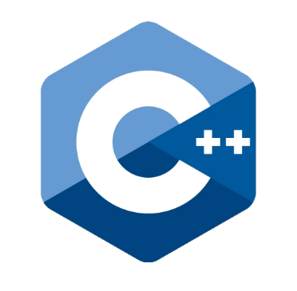


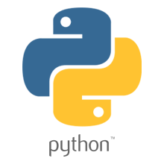


How to develop an application?
Supported Languages:

Slide 22
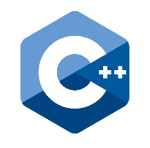




How to develop an application?
Supported development OS:
UWP
UNIVERSAL WINDOWS PLATFORM
Notes:
- Before we start from OS we need to clarify on keyword
Keyword: Universal Windows Platform - Universal Apps
Universal app supports all those languages

Slide 23
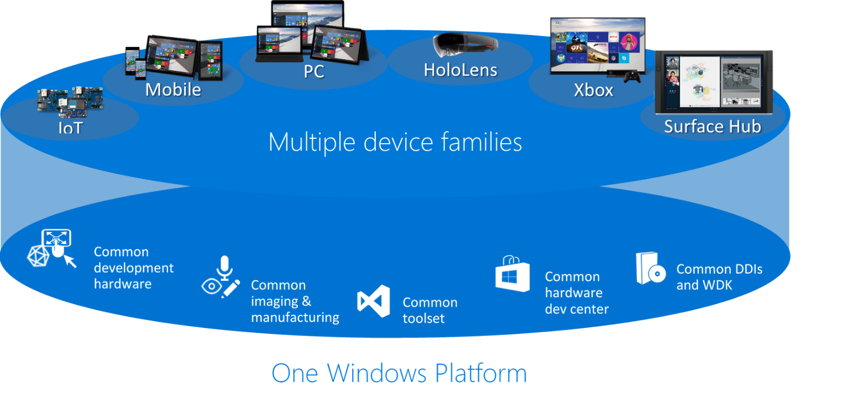
How to develop an application?
Universal Windows Platform
Notes:
- In windows 10 MS has introduced Universal Apps
- Universal apps are supported by all windows 10 distributions
- It means that we can write single application (based on basic libraries) that runs on every single decice: mobile, xbox, pc, IoT

Slide 24
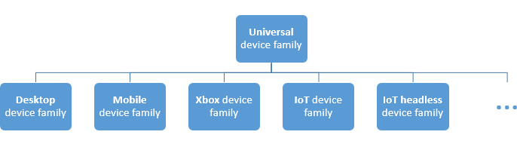
How to develop an application?
Universal Windows Platform

Slide 25
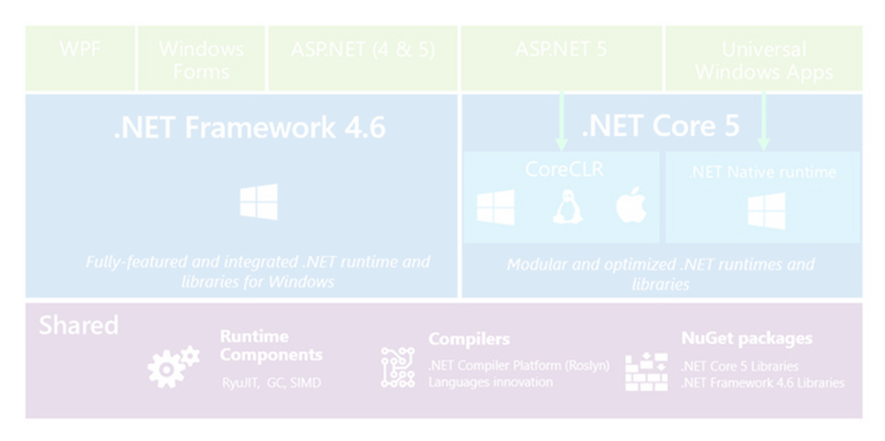
How to develop an application?
CAN I EASLY DEVELOP IT
ON MY MAC AND LINUX?
Universal Windows Platform
Notes:
- no

Slide 26

How to develop an application?
NO
Universal Windows Platform
Notes:
- no

Slide 27
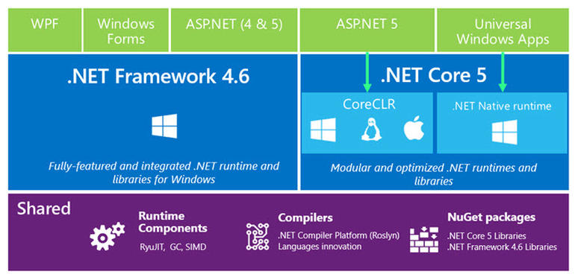
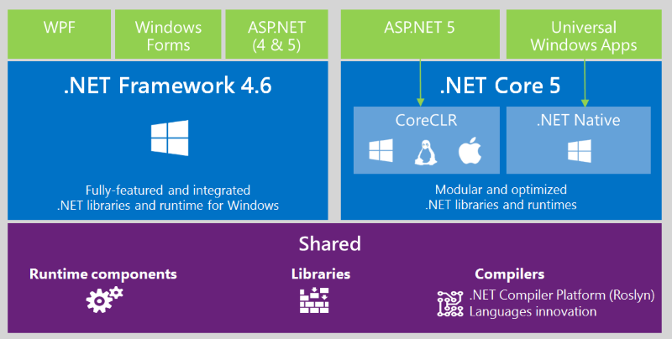
How to develop an application?
Universal Windows Platform
Notes:
- So, MS has opened .Net Core, ASP .Net 5 can be developed and run! Also on Linux and OSX. Can we develop Universal apps in same maner?

Slide 28

How to develop an application?
UWP
UNIVERSAL WINDOWS PLATFORM
Notes:
- Universal Windows Apps development/build/deployment is strictly bound with Windows 10 (we can also develop them and run on Windows 8, and develop on windows 7)

Slide 29


How to develop an application?
?
UWP
UNIVERSAL WINDOWS PLATFORM
Notes:
Any alternative for Universal Applications?
YES

Slide 30
How to develop an application?
Universal Windows Platform
Notes:
.NET Core is a self-contained .NET runtime
.NET Core is ported to many achritectures and platforms
.Net Native compile c# to native machine code (performs like C++) 60% faster 15-20% less memory
Universal Windows App in debug run on CoreCLR
Problem is DNX (.Net Runtime Environment) that is used to run .NetCore on all platforms (doesnt support >NetCore.UniversalWindowsPlatform)
So, MS has opened .Net Core, ASP .Net 5 can be developed and run! Also on Linux and OSX. Can we develop Universal apps in same maner?

Slide 31
How to develop an application?
C# CoreCLR via DNX
UWP
UNIVERSAL WINDOWS PLATFORM
Node.js (Chakra build)
Notes:
We can develop application for CoreCLR and deploy it with DNX (self contained .net application) however you don’t have access to IoT libraries!
It’s good wen you want to settle asp.net server / console application
Standalone Node.js? You can do whatever you want, however you want it’s javascript
You need to remember it’s not visible as a headed or headless app
No access to GPIO!
You deploying it to IOT by simple copy

Slide 32
How to develop an application?
Standalone Node.js app
Download ARM Node.js build for Chakra
github.com/ms-iot/ntvsiot/releases
Copy node.exe to device (i.e. C:\Node)
Setup firewall rule
netsh advfirewall firewall add rule name="Node.js" dir=in action=allow program="C:\Node\node.exe" enable=yes
To Run:
(Powershell):
& 'C:\Node\node.exe' 'C:\Node\server.js' OR start-process 'C:\Node\node.exe' 'C:\Node\server.js' (SSH): node.exe server.js
Notes:
In previous Windows 10 IoT build you have to download node sources, copy them to raspberry, compile with chakra
Now you have
https://github.com/Microsoft/node
https://github.com/ms-iot/node-uwp-wrapper

Slide 33
How to develop an application?
Standalone Node.js app with all UWP features:
Deploy Node.js UWP app (i.e IoT.Demo.Node.WebServer)
Set as startup and reboot
IotStartup add headless <Node_Uwp_app> shutdown r/ t/ 0
Now you can modifie/add .js files in project directory :
C:/Data/Users/DefaultAccount/AppxLayouts/<Node_Uwp_app>
To reload simply kill your app process
kill <PID or Node_Uwp_app_name>
Notes:
Show

Slide 34
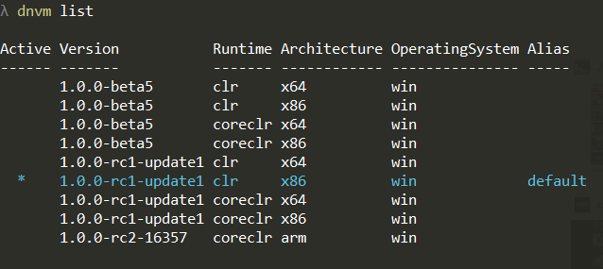
How to develop an application?
Standalone C# DNX application
Install DVNM (.Net version manager) on development machine
Windows: http://docs.asp.net/en/latest/getting-started/installing-on-windows.html
Linux: http://docs.asp.net/en/latest/getting-started/installing-on-linux.html
OSX: http://docs.asp.net/en/latest/getting-started/installing-on-mac.html
Update DVNM and download ARM coreCLR
dnvm update-self dnvm install latest -r coreclr -arch ARM -u
Check if ARM coreCLR has been correctly installed
dnvm list

Slide 35
How to develop an application?
Standalone C# DNX application
Create .NetCore project via VS2015 (Windows) or generate with Yeoman (Linux/OSX/Windows)
Rebuild project
Publish package in ARM runtime (Run in you project.json location)
dnu publish --out <output_dir> --no-source --runtime dnx-coreclr-win-arm.1.0.0-rc2-16357
Copy <output-dir> to IoT device directory
Run yourApplicationName.cmd from main path

Slide 36
DEMO
How to develop universal applications in practice

Slide 37

Tools
Visual Studio 2015 (Community edition for free) + Update 1 + Universal Windows App Development Tools (Tools and Windows SDK)
Windows IoT Core Project Templates (via Visual Studio Gallery)
Optionally:
Node.js Tool for Windows IoT ( https://github.com/ms-iot/ntvsiot/releases )

Slide 38
DEMO: Basic Headed apps
Demos:
IoT.Demo.Headed.Xaml
Template: Windows/Templates/Visual C#/Windows/Universal/Blank App
IoT.Demo.Headed.Js
Template: Windows/Templates/JavaScript/Windows/Universal/Blank App
Notes:
JS:
WinJs – frontend js library (support for Knockout, Angular, React)

Slide 39
DEMO: Remote debug
Setup ‘Debug’ inside project (.csproj) properties:

Slide 40
DEMO: Create Package
Store -> Create App Packages…

Slide 41
DEMO: Node.js + Universal app
Demos:
IoT.Demo.Node.WebServer
Template: Windows/Templates/JavaScript/Node.js/Basic Node.js Web Server (Universal Windows)
Details about UWP Node.js wrapper: https://github.com/ms-iot/node-uwp-wrapper
Create Package: - Open Developer Command Prompt for VS 2015. (Cmd with VS2015 tools)
- Navigate to your project.
- Run msbuild /p:configuration=release /p:platform=arm
- After running the command above, you should see a new folder with the AppX in: \Your project root\AppPackages.

Slide 42
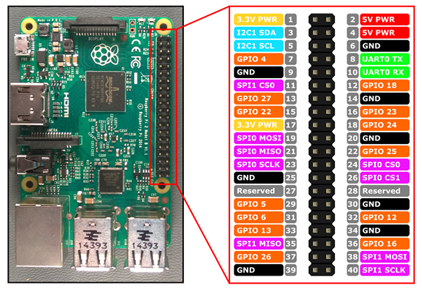
DEMO: GPIO and other I/O stuff
17x GPIO pins
2x SPI bus
1x I2C bus
2x 5.0V Power pins
2x 3.3V Power pins
1x UART
8x Ground pins

Slide 43
DEMO: GPIO read/write
Demos:
IoT.Demo.Gpio
Notes:
- Show Different open ways (exclusive, shared read-only)
- Show Different drive modes:
- Input (floating + high impedance), InputPullUp, InputPullDown
- Output
- OutputOpenDrain: Low = low, High = high impedance + floating
- OutputOpenDrainPullUp: Low = low, High = high impedance + pulled to VCC (when nothing connected)
- OutputOpenSource: High= High, Low = high impedance + floating
- OutputOpenSourcePullDown: High= High, Low = high impedance + pulled to ground (when nothing connected)

Slide 44
DEMO: PWM. not only software
Demos:
IoT.Demo.Gpio.Pwm
References: (https://github.com/ms-iot/BusProviders/tree/develop/PWM)
PwmSoftware (C++) PwmPCA9685 (C++)
Notes:
Show link. (In Bus providers you can find many interesting things)
Show how easy you can switch PwmController

Slide 45
DEMO: Buses
Demos:
IoT.Demo.Buses
Notes:
Show SPI, I2C,

Slide 46
Q&A

Slide 47
THANK YOU!

